Slide 1
Showing your working: a how to guide to reproducible research

Slide 2
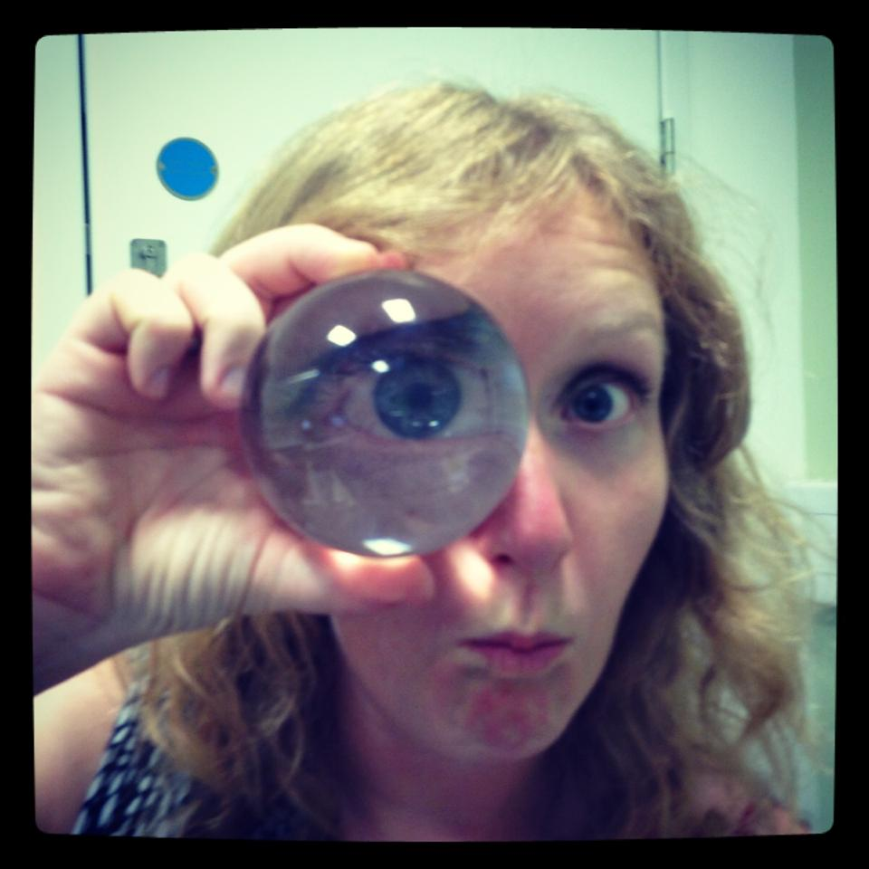

Research fellow at the Alan Turing Institute for Data Science
Research associate in the Brain Mapping Unit, Department of Psychiatry, University of Cambridge
2016/17 Mozilla Fellow for Science

Slide 3
Reproducible vs Replicable

Slide 4
 |  | Data
 |  | Same | Different
Code | Same
 | Different

Slide 5
 |  | Data
 |  | Same | Different
Code | Same | Reproducible
 | Different

Slide 6
 |  | Data
 |  | Same | Different
Code | Same | Reproducible | Replicable
 | Different

Slide 7
 |  | Data
 |  | Same | Different
Code | Same | Reproducible | Replicable
 | Different | Robust

Slide 8
 |  | Data
 |  | Same | Different
Code | Same | Reproducible | Replicable
 | Different | Robust | Generalisable

Slide 9
Barriers to reproducible research

Slide 10
Barriers to reproducible research
Is not considered for promotion
Requires additional skills
Plead the 5th
Support additional users
Takes time
Held to higher standards than others
Publication bias towards novel findings

Slide 11
Barriers to reproducible research
Is not considered for promotion
Requires additional skills
Plead the 5th
Support additional users
Takes time
Held to higher standards than others
Publication bias towards novel findings

Slide 12
Barriers to reproducible research
Is not considered for promotion
Requires additional skills
Plead the 5th
Support additional users
Takes time
Held to higher standards than others
Publication bias towards novel findings

Slide 13
Barriers to reproducible research
Is not considered for promotion
Requires additional skills
Plead the 5th
Support additional users
Takes time
Held to higher standards than others
Publication bias towards novel findings

Slide 14
Barriers to reproducible research
Is not considered for promotion
Requires additional skills
Plead the 5th
Support additional users
Takes time
Held to higher standards than others
Publication bias towards novel findings

Slide 15
Barriers to reproducible research
Is not considered for promotion
Requires additional skills
Plead the 5th
Support additional users
Takes time
Held to higher standards than others
Publication bias towards novel findings

Slide 16
Barriers to reproducible research
Is not considered for promotion
Requires additional skills
Plead the 5th
Support additional users
Takes time
Held to higher standards than others
Publication bias towards novel findings

Slide 17
Start small

Slide 18
Protocols.io

Slide 19
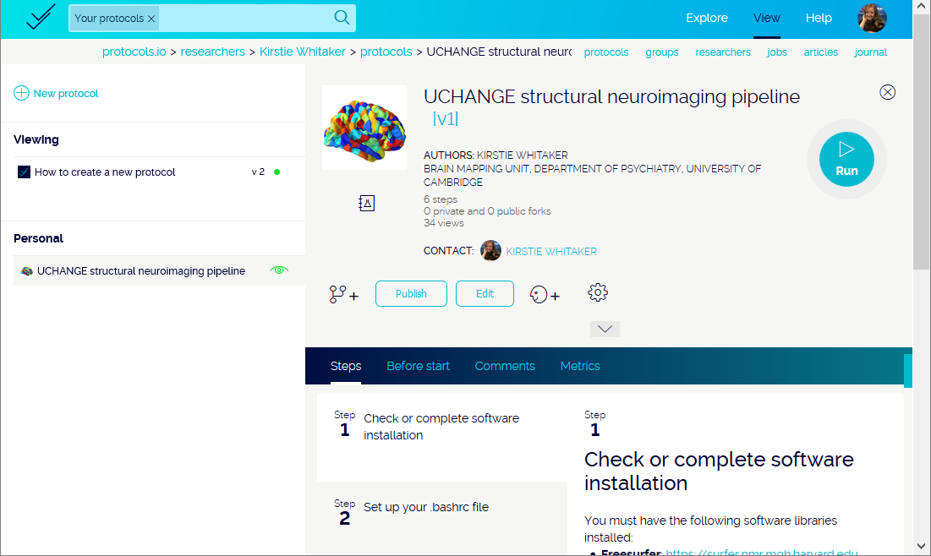

Slide 20
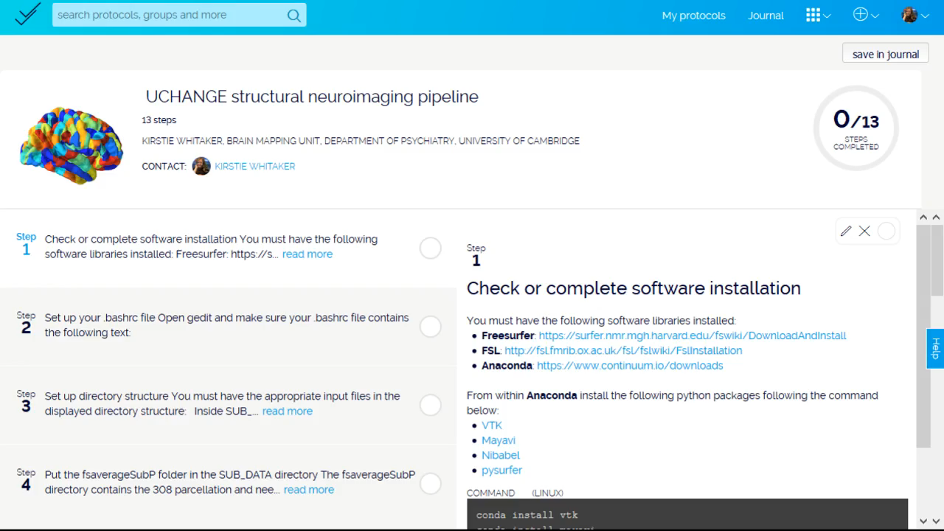

Slide 21
Coding your analyses

Slide 22
Comments are your friend!

Slide 23
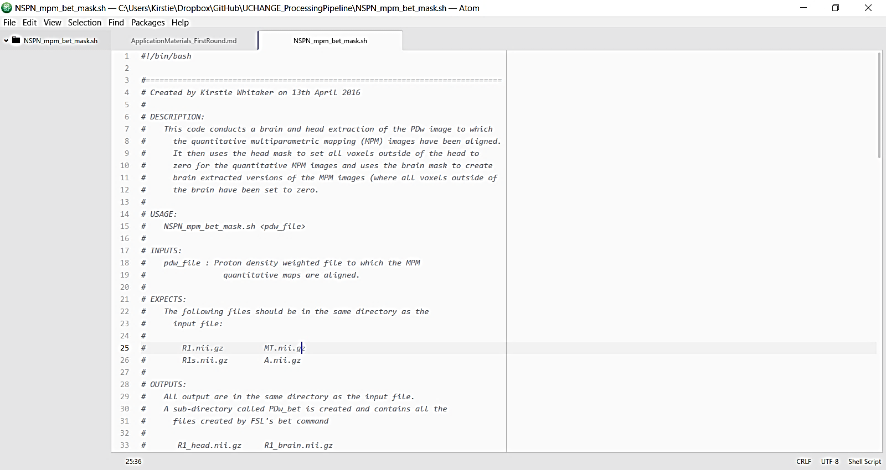
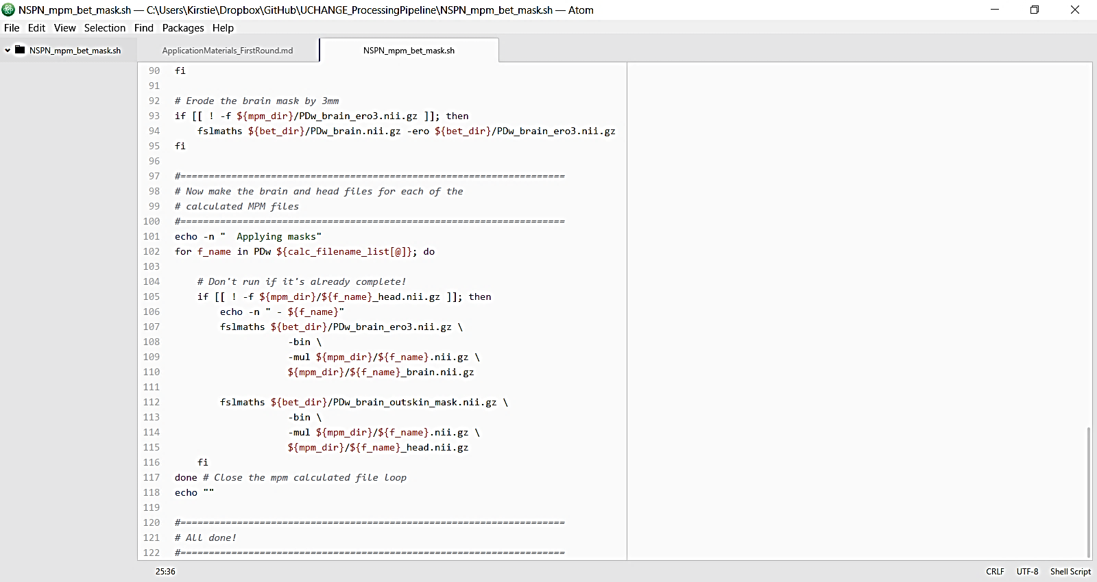

Slide 24
Aim for 40% comments in your code

Slide 25
Share your comments with the original author

Slide 26
(which is almost always going to be YOU!)

Slide 27
Python vs R (vs Matlab vs STATA etc…)

Slide 28
R Studio
https://www.rstudio.com

Slide 29
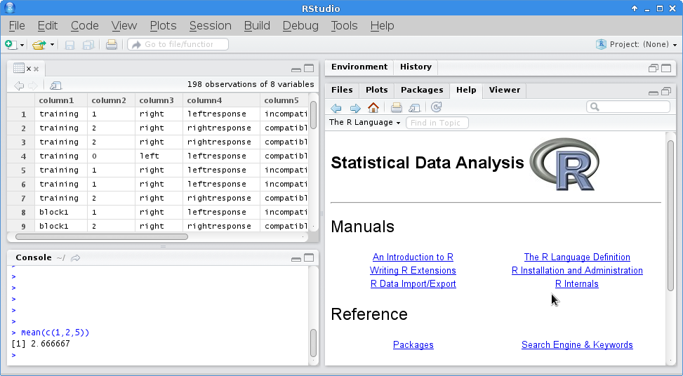
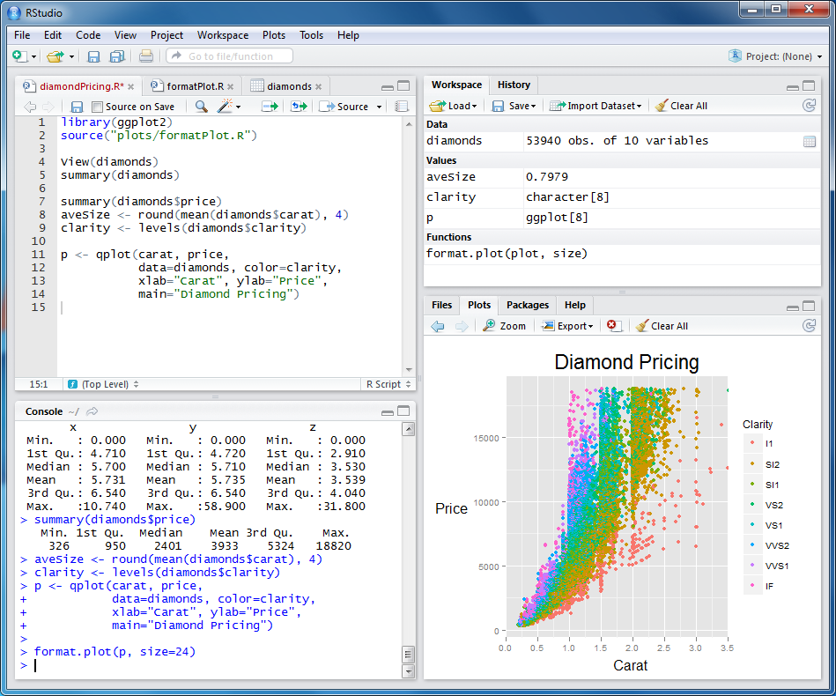

Slide 30
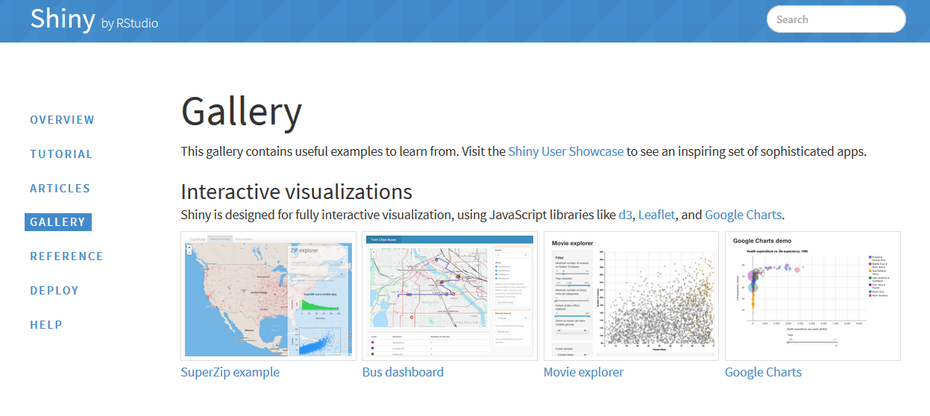
Shiny gallery

Slide 31

Anaconda

Slide 32
Matplotlib & Seaborn
http://matplotlib.org
http://stanford.edu/~mwaskom/software/seaborn

Slide 33
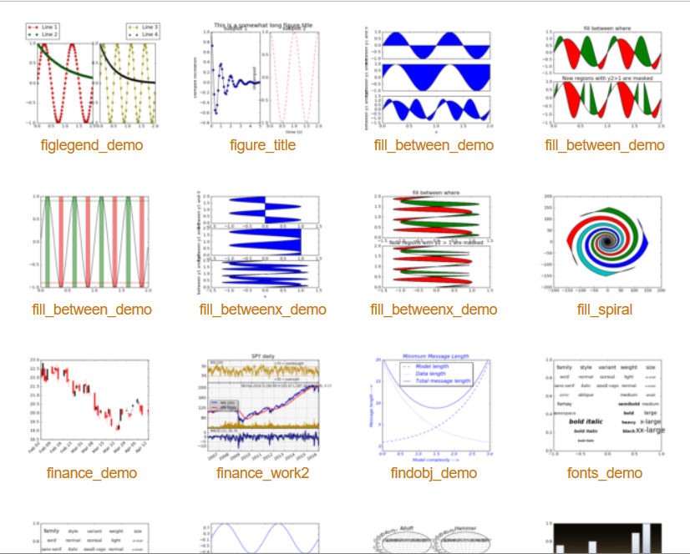
Matplotlib & Seaborn
Matplotlib gallery
Click each example to see source code

Slide 34
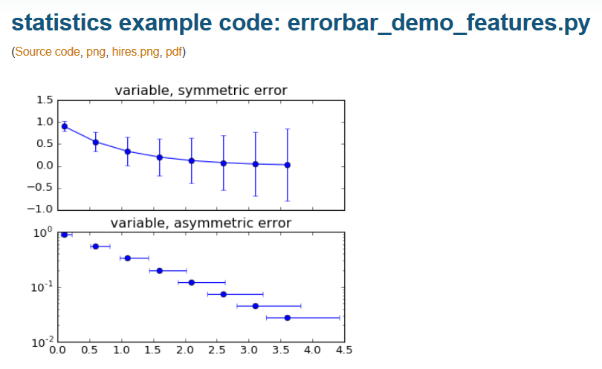
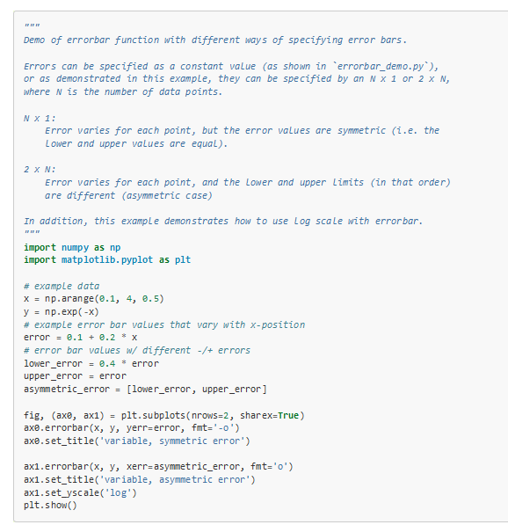
http://matplotlib.org/examples/statistics/errorbar_demo_features.html

Slide 35
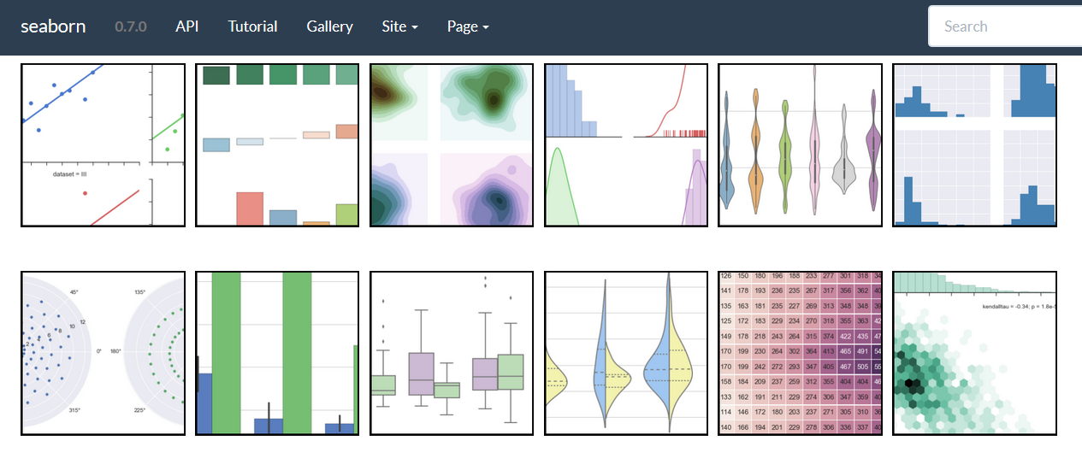
Matplotlib & Seaborn
Seaborn gallery

Slide 36

Jupyter Notebook
http://jupyter.org

Slide 37
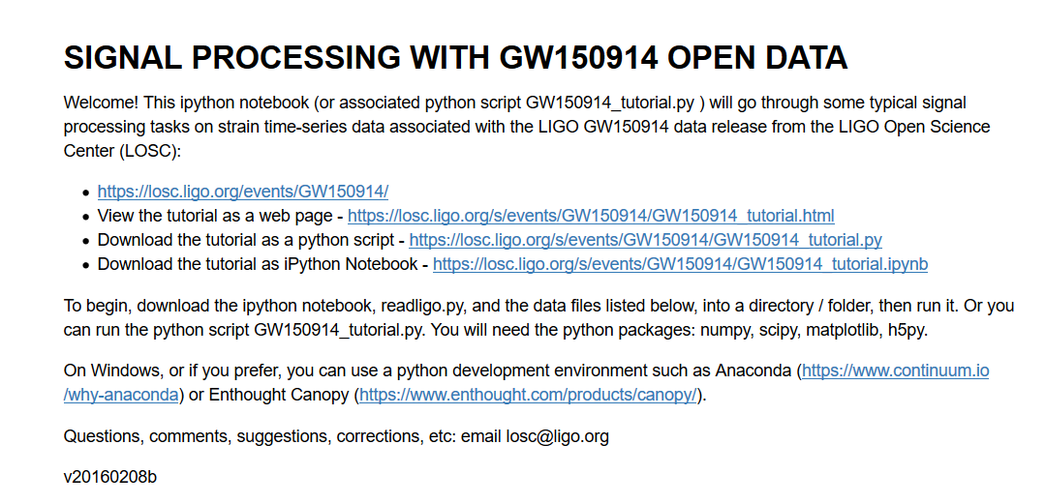
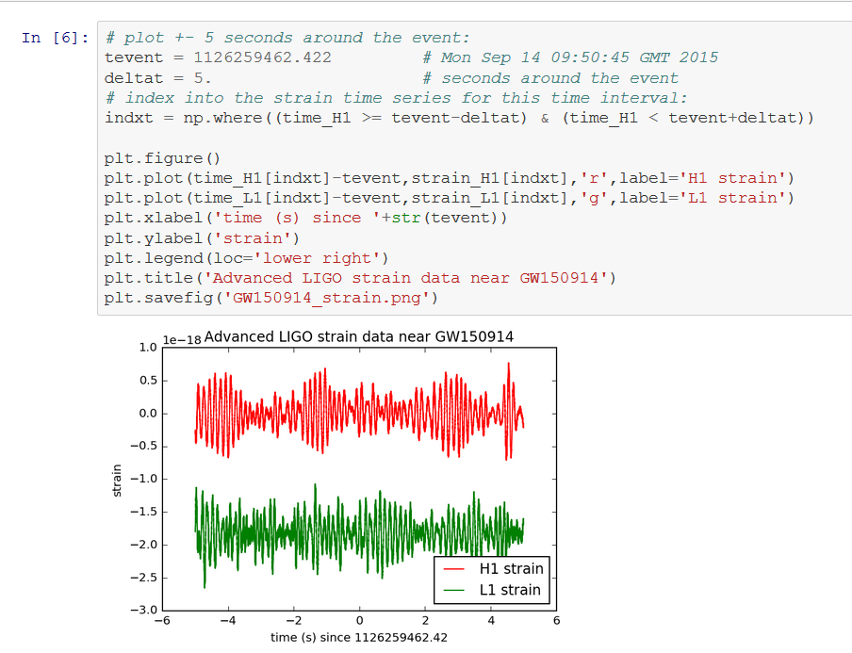
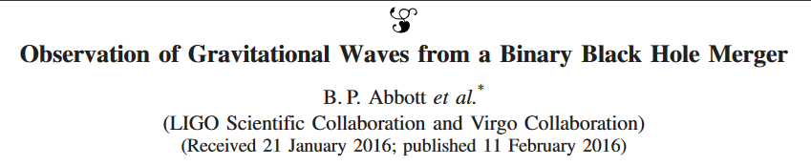
https://losc.ligo.org/s/events/GW150914/GW150914_tutorial.html
Notes:
https://losc.ligo.org/s/events/GW150914/GW150914_tutorial.html

Slide 38
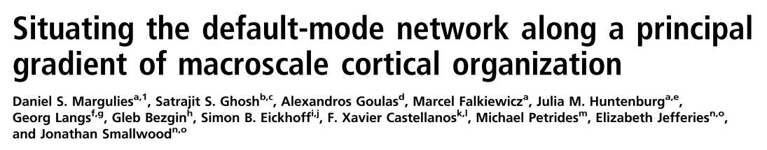
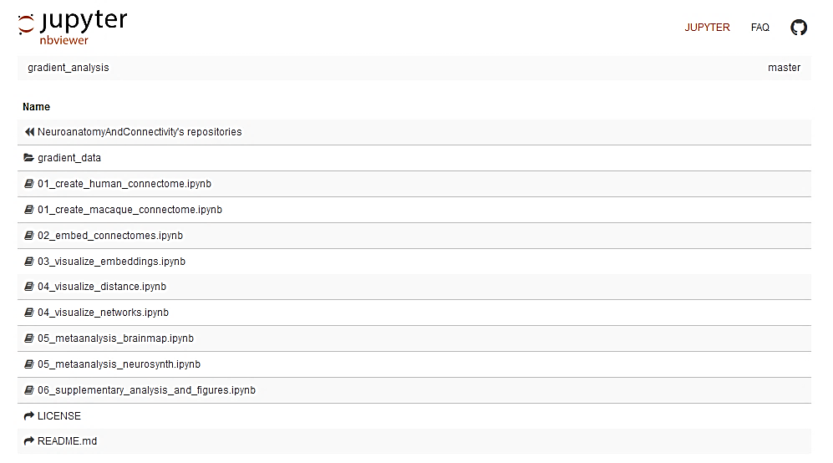
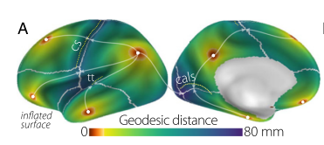
DOI: 10.1073/pnas.1608282113
Notes:
https://losc.ligo.org/s/events/GW150914/GW150914_tutorial.html

Slide 39
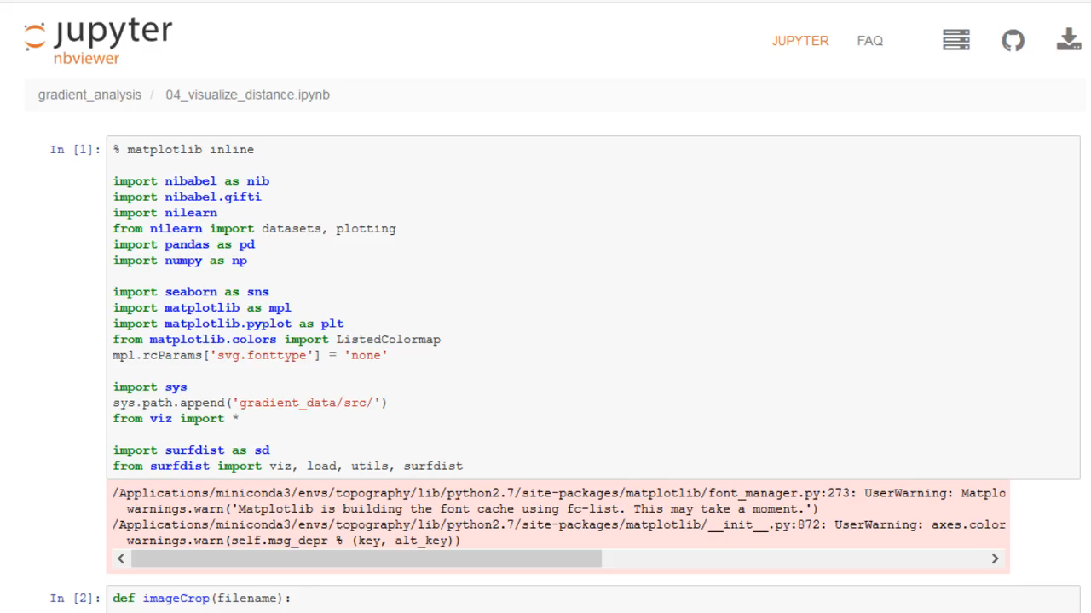

Slide 40
Asking for help: StackOverflow & MWEs
http://stackoverflow.com

Slide 41
Git vs GitHub

Slide 42
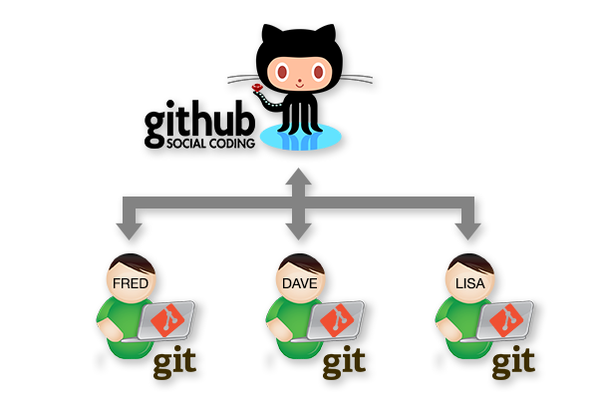

Slide 43
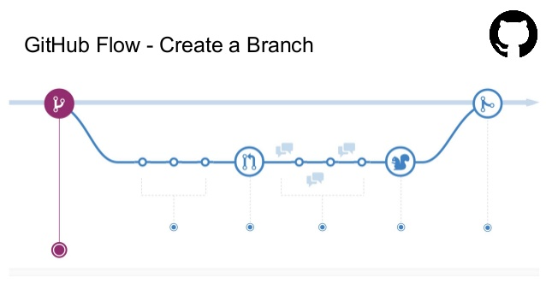
http://www.slideshare.net/nishanbose/introduction-to-github-55872492/7

Slide 44
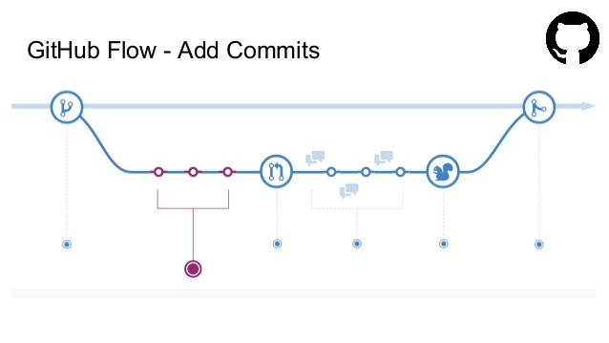
http://www.slideshare.net/nishanbose/introduction-to-github-55872492/7

Slide 45
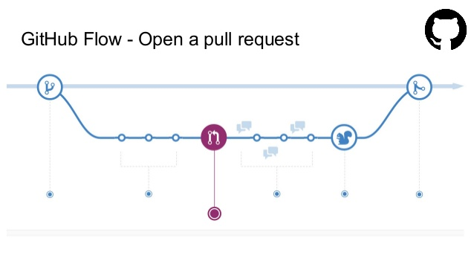
http://www.slideshare.net/nishanbose/introduction-to-github-55872492/7

Slide 46
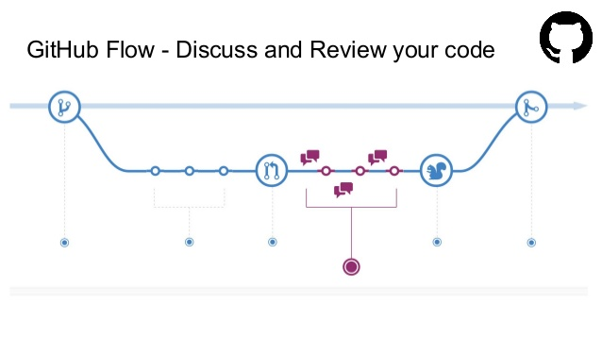
http://www.slideshare.net/nishanbose/introduction-to-github-55872492/7

Slide 47
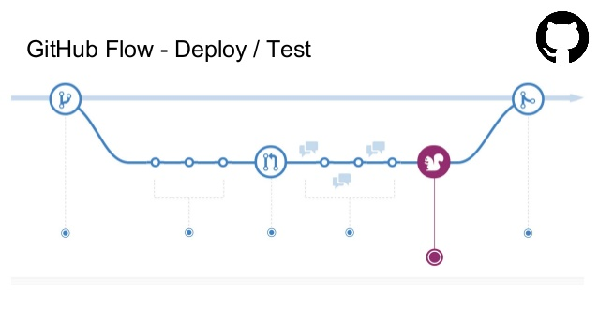
http://www.slideshare.net/nishanbose/introduction-to-github-55872492/7

Slide 48
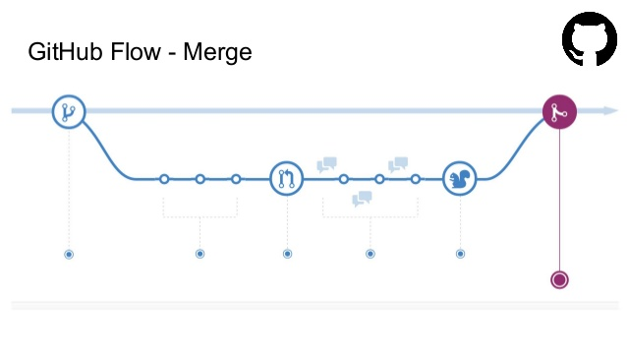
http://www.slideshare.net/nishanbose/introduction-to-github-55872492/7
Notes:
http://www.slideshare.net/nishanbose/introduction-to-github-55872492/7

Slide 49
www.GitHub.com/ KirstieJane/ ReproducibleResearch

Slide 50
Some jargon busting
Clone
Repository
Pull request
Branch
Version control
Merge
Issues
Release
Commit
Fork
Markdown

Slide 51
Submit your first pull request!
Inspired by: https://yourfirstpr.github.io

Slide 52
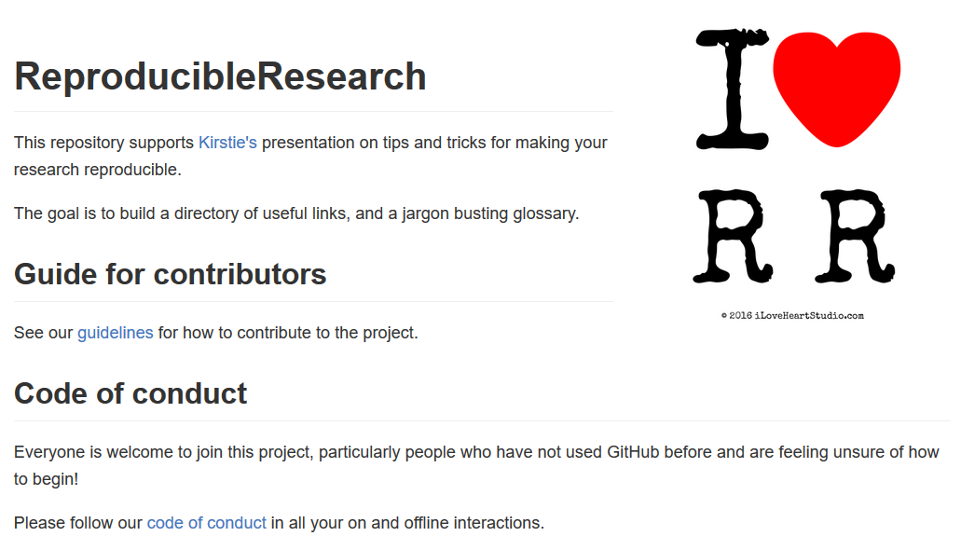
Submit your first pull request!
Inspired by: https://yourfirstpr.github.io

Slide 53
Create a glossary

Slide 54
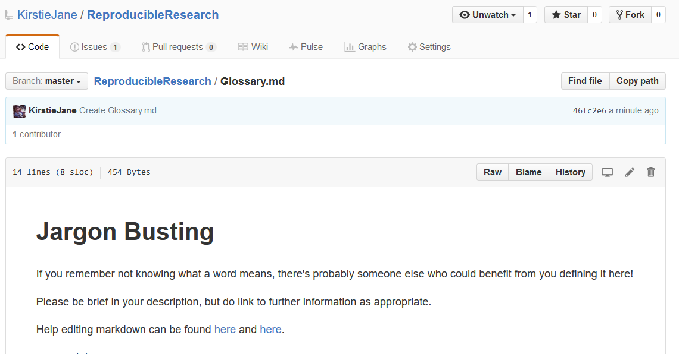
Create a glossary

Slide 55
Share resources

Slide 56
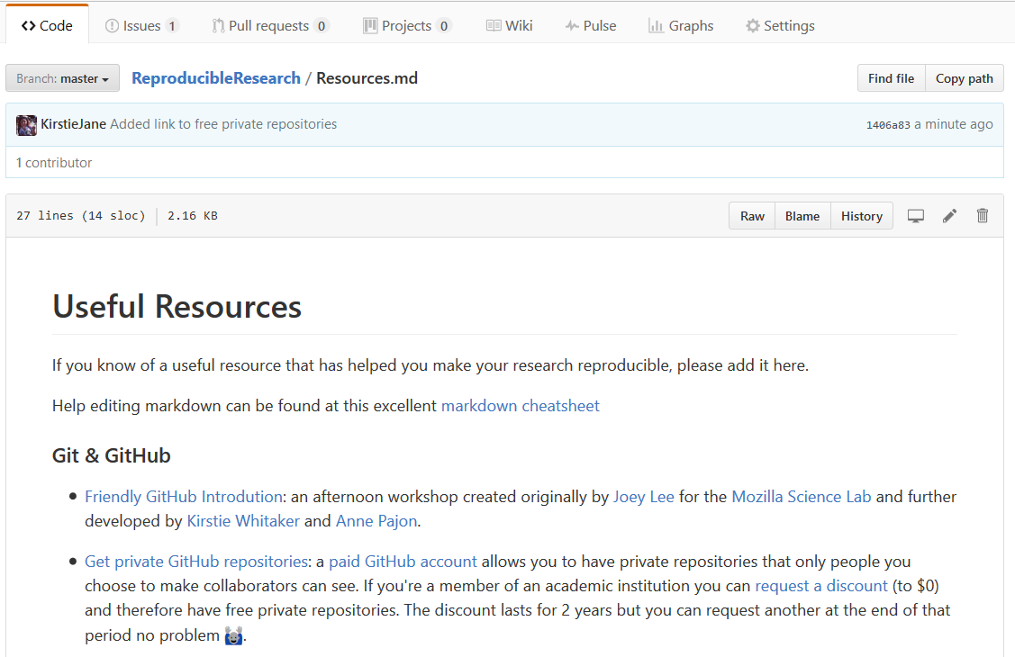

Slide 57





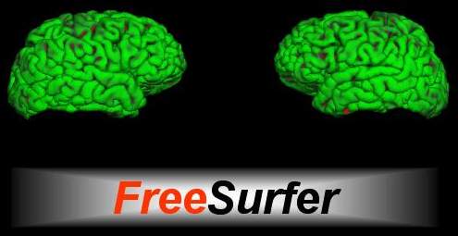
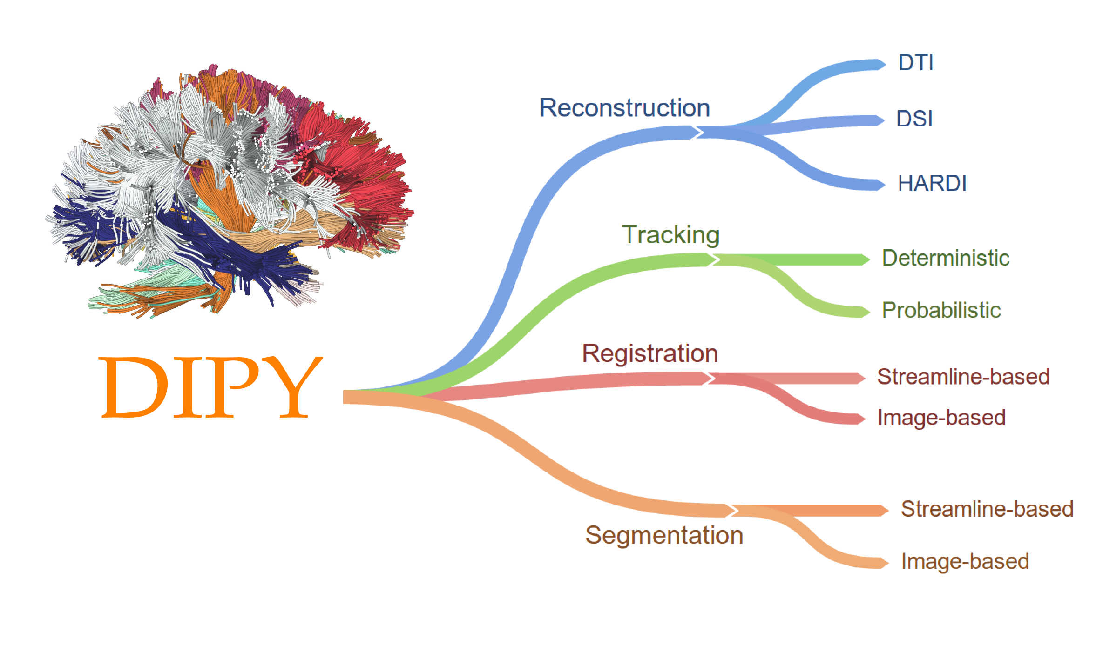
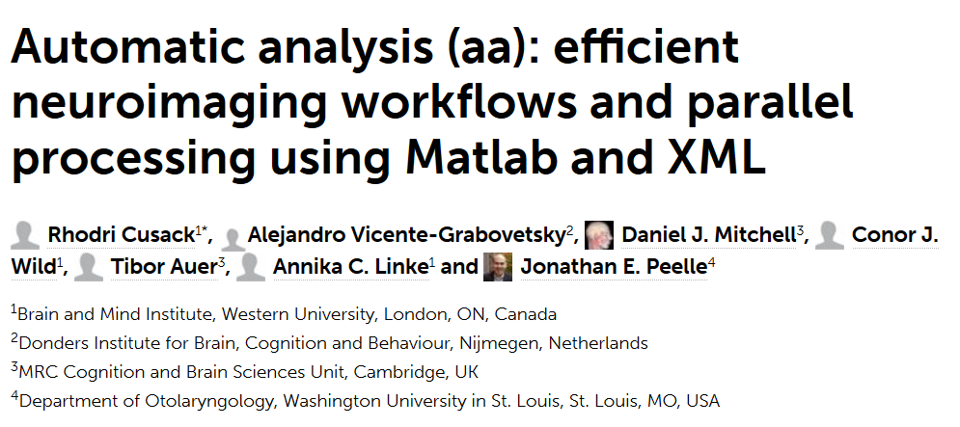
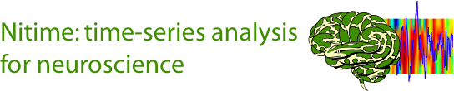

Slide 58



Community
https://www.mozillascience.org
http://software-carpentry.org
http://data-carpentry.org
https://www.coursera.org/specializations/jhu-data-science
https://www.coursera.org/learn/python/home/info

Slide 59




Thank you!
KirstieJane/ReproducibleResearch
@kirstie_j
doi: 10.6084/m9.figshare.4244996

